Slide 1
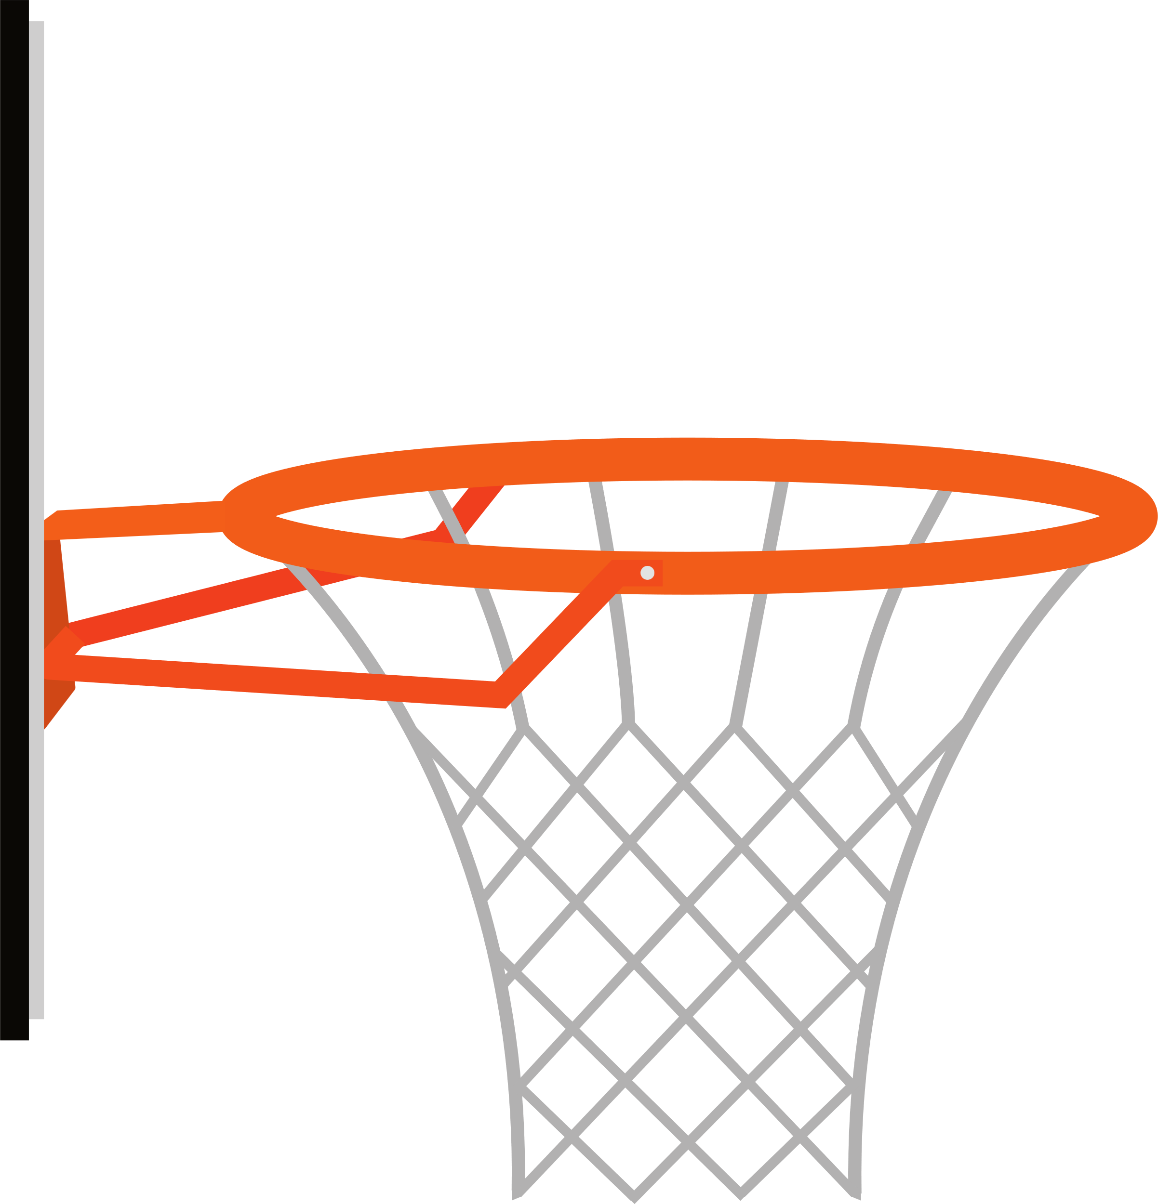
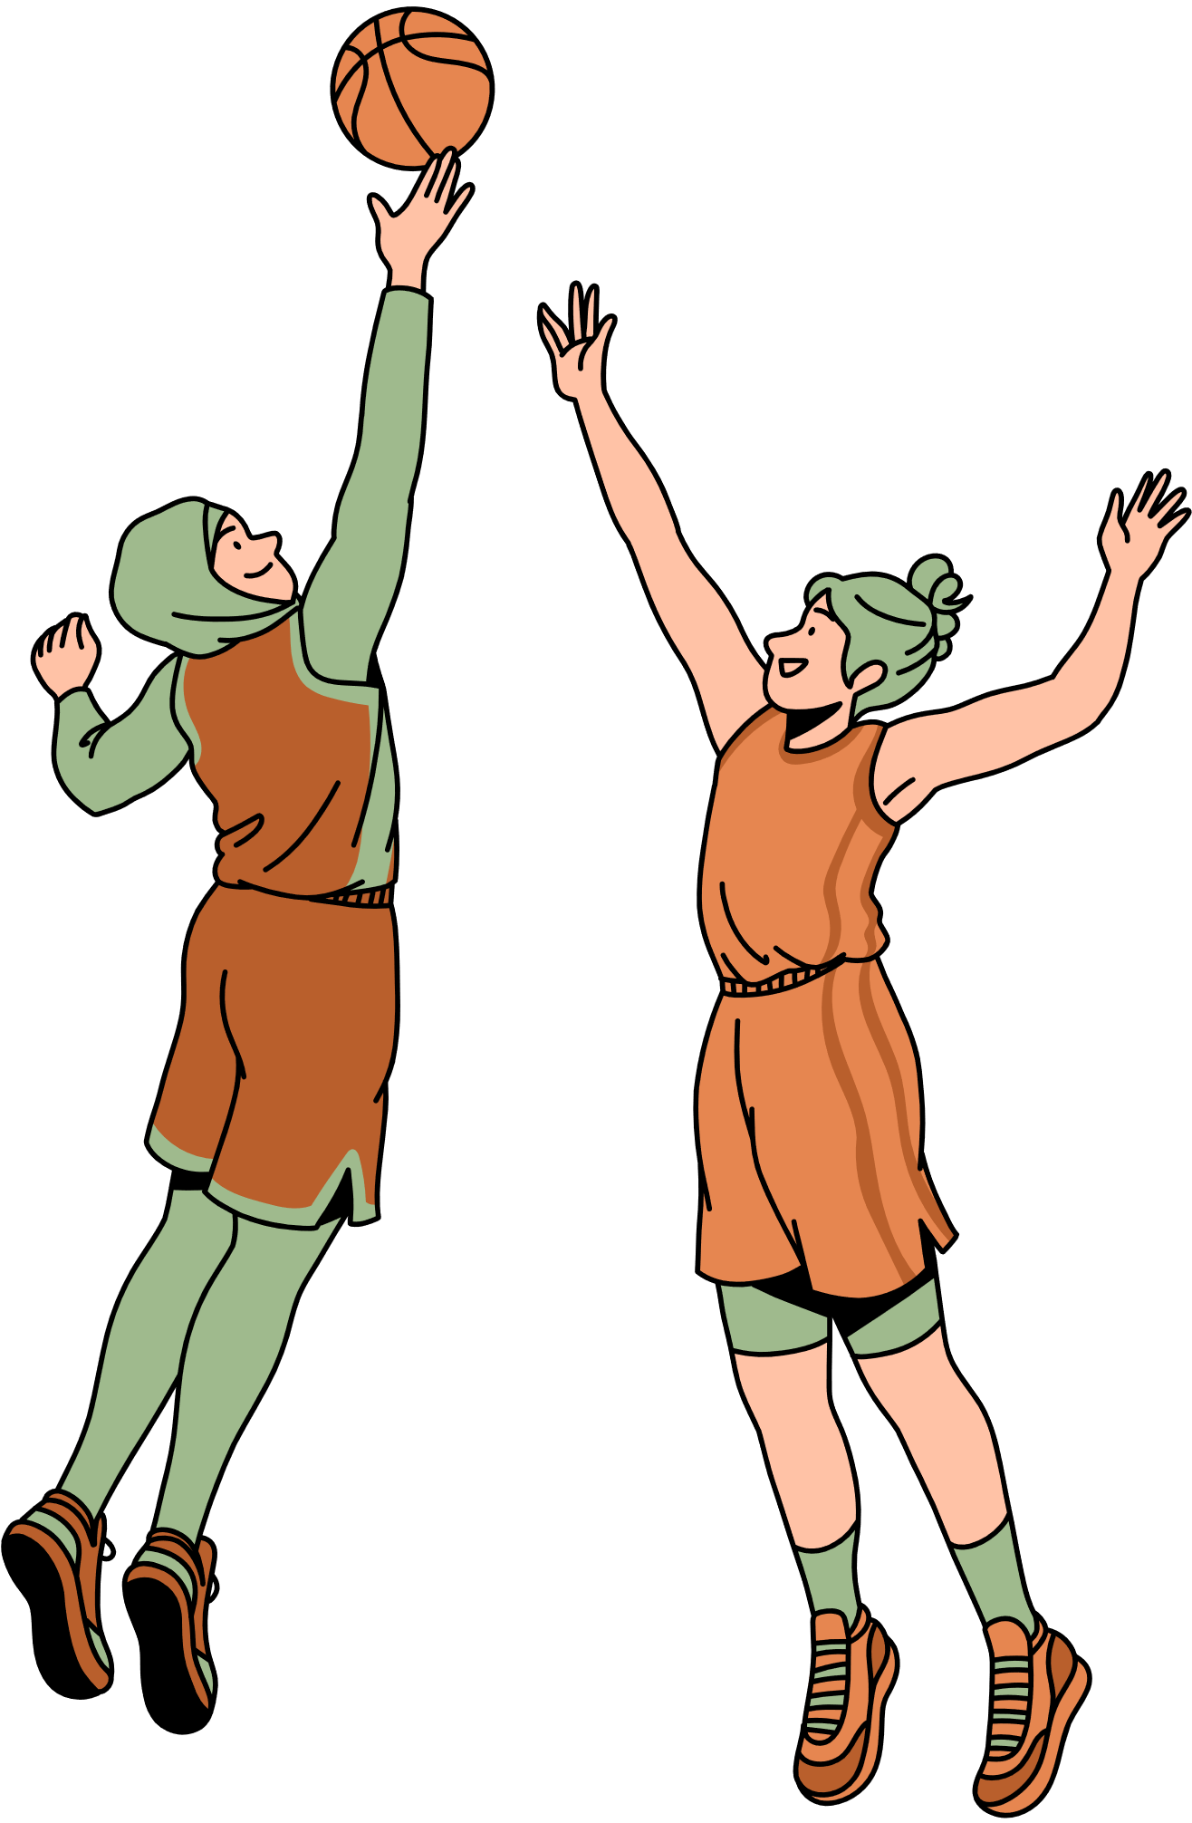
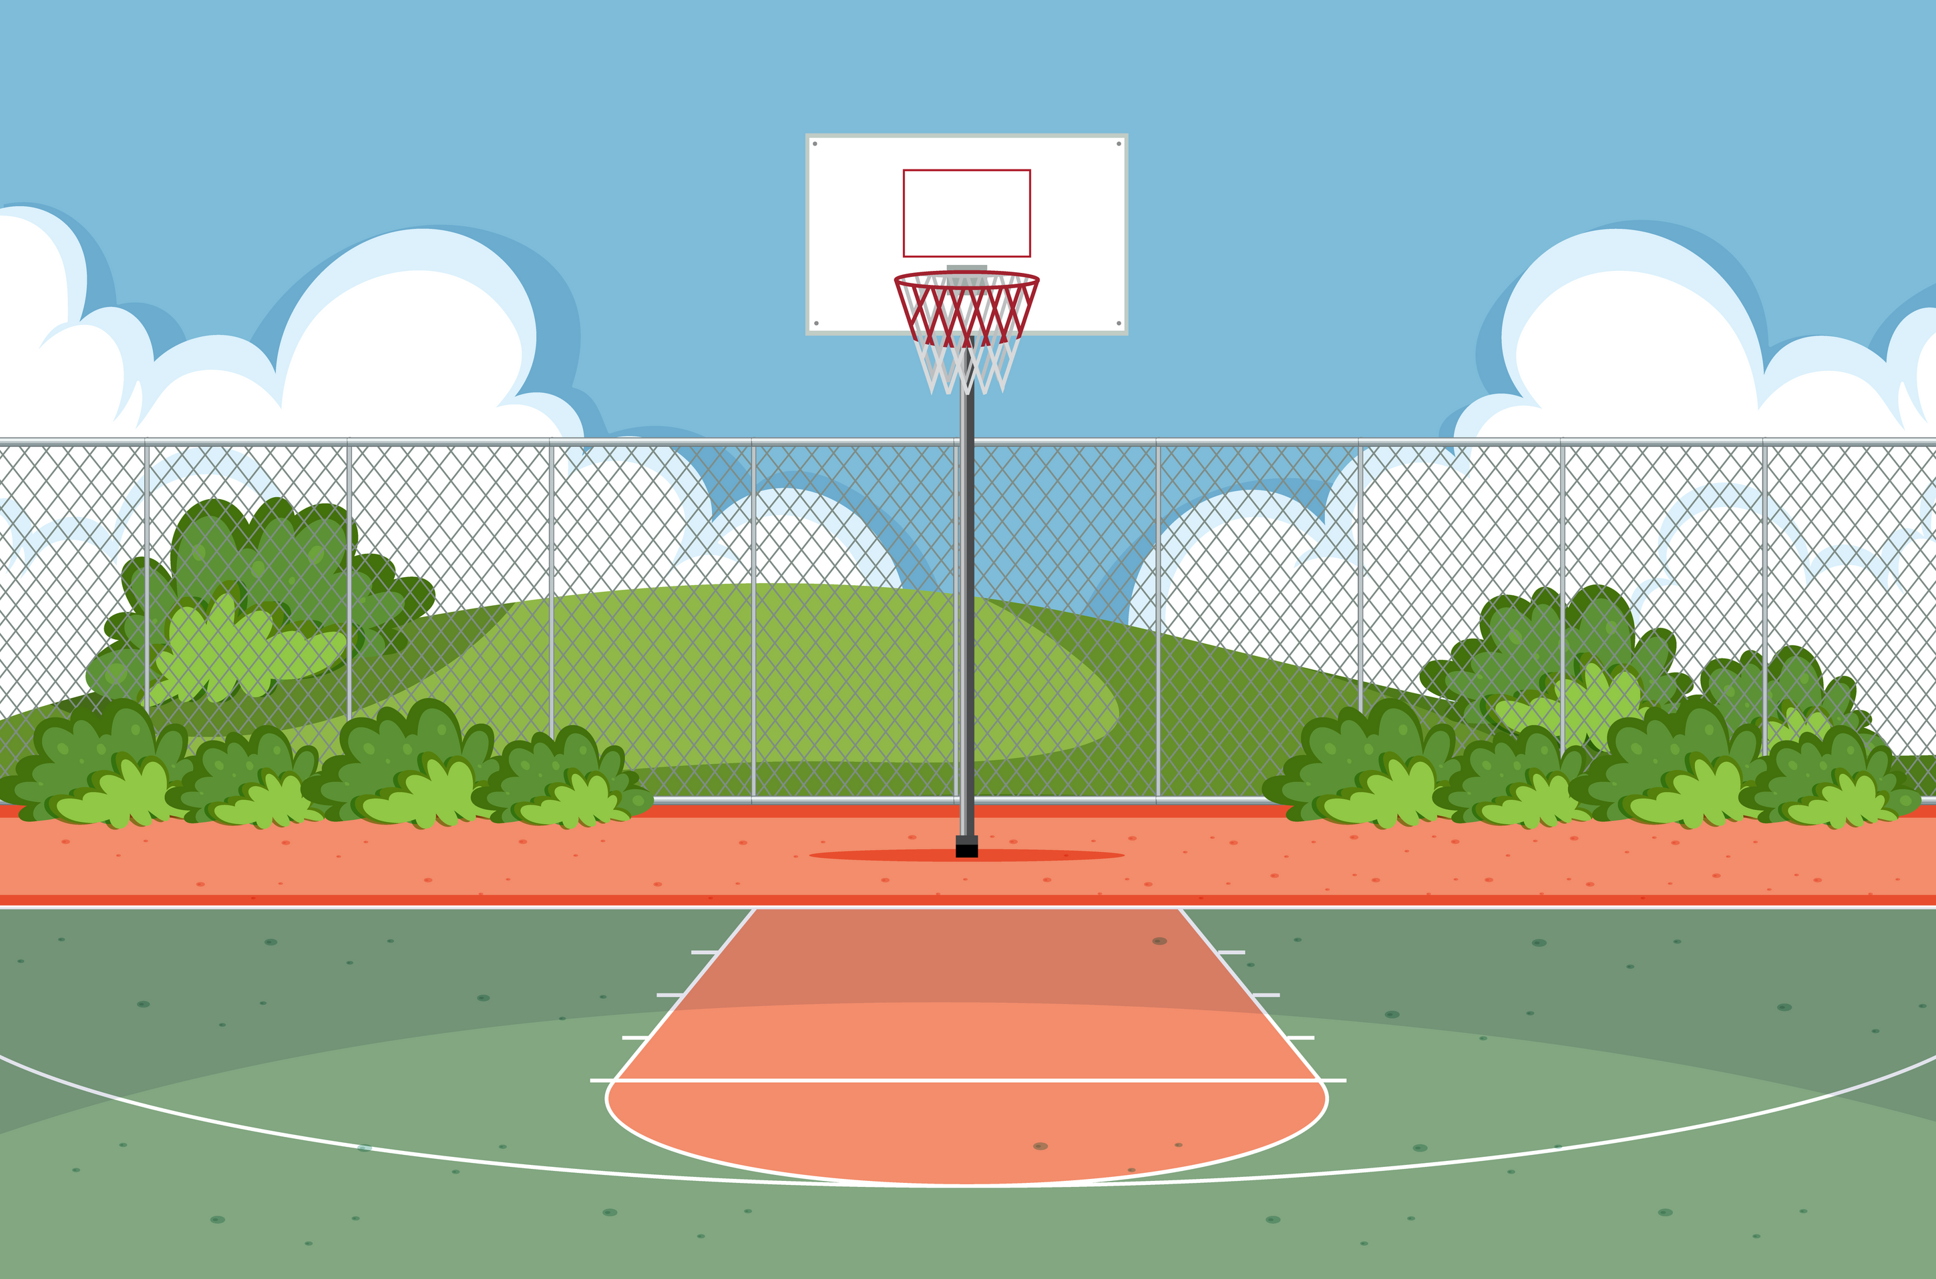
SPOrtlets
Analysing Freethrow through Local Submovements

Slide 2
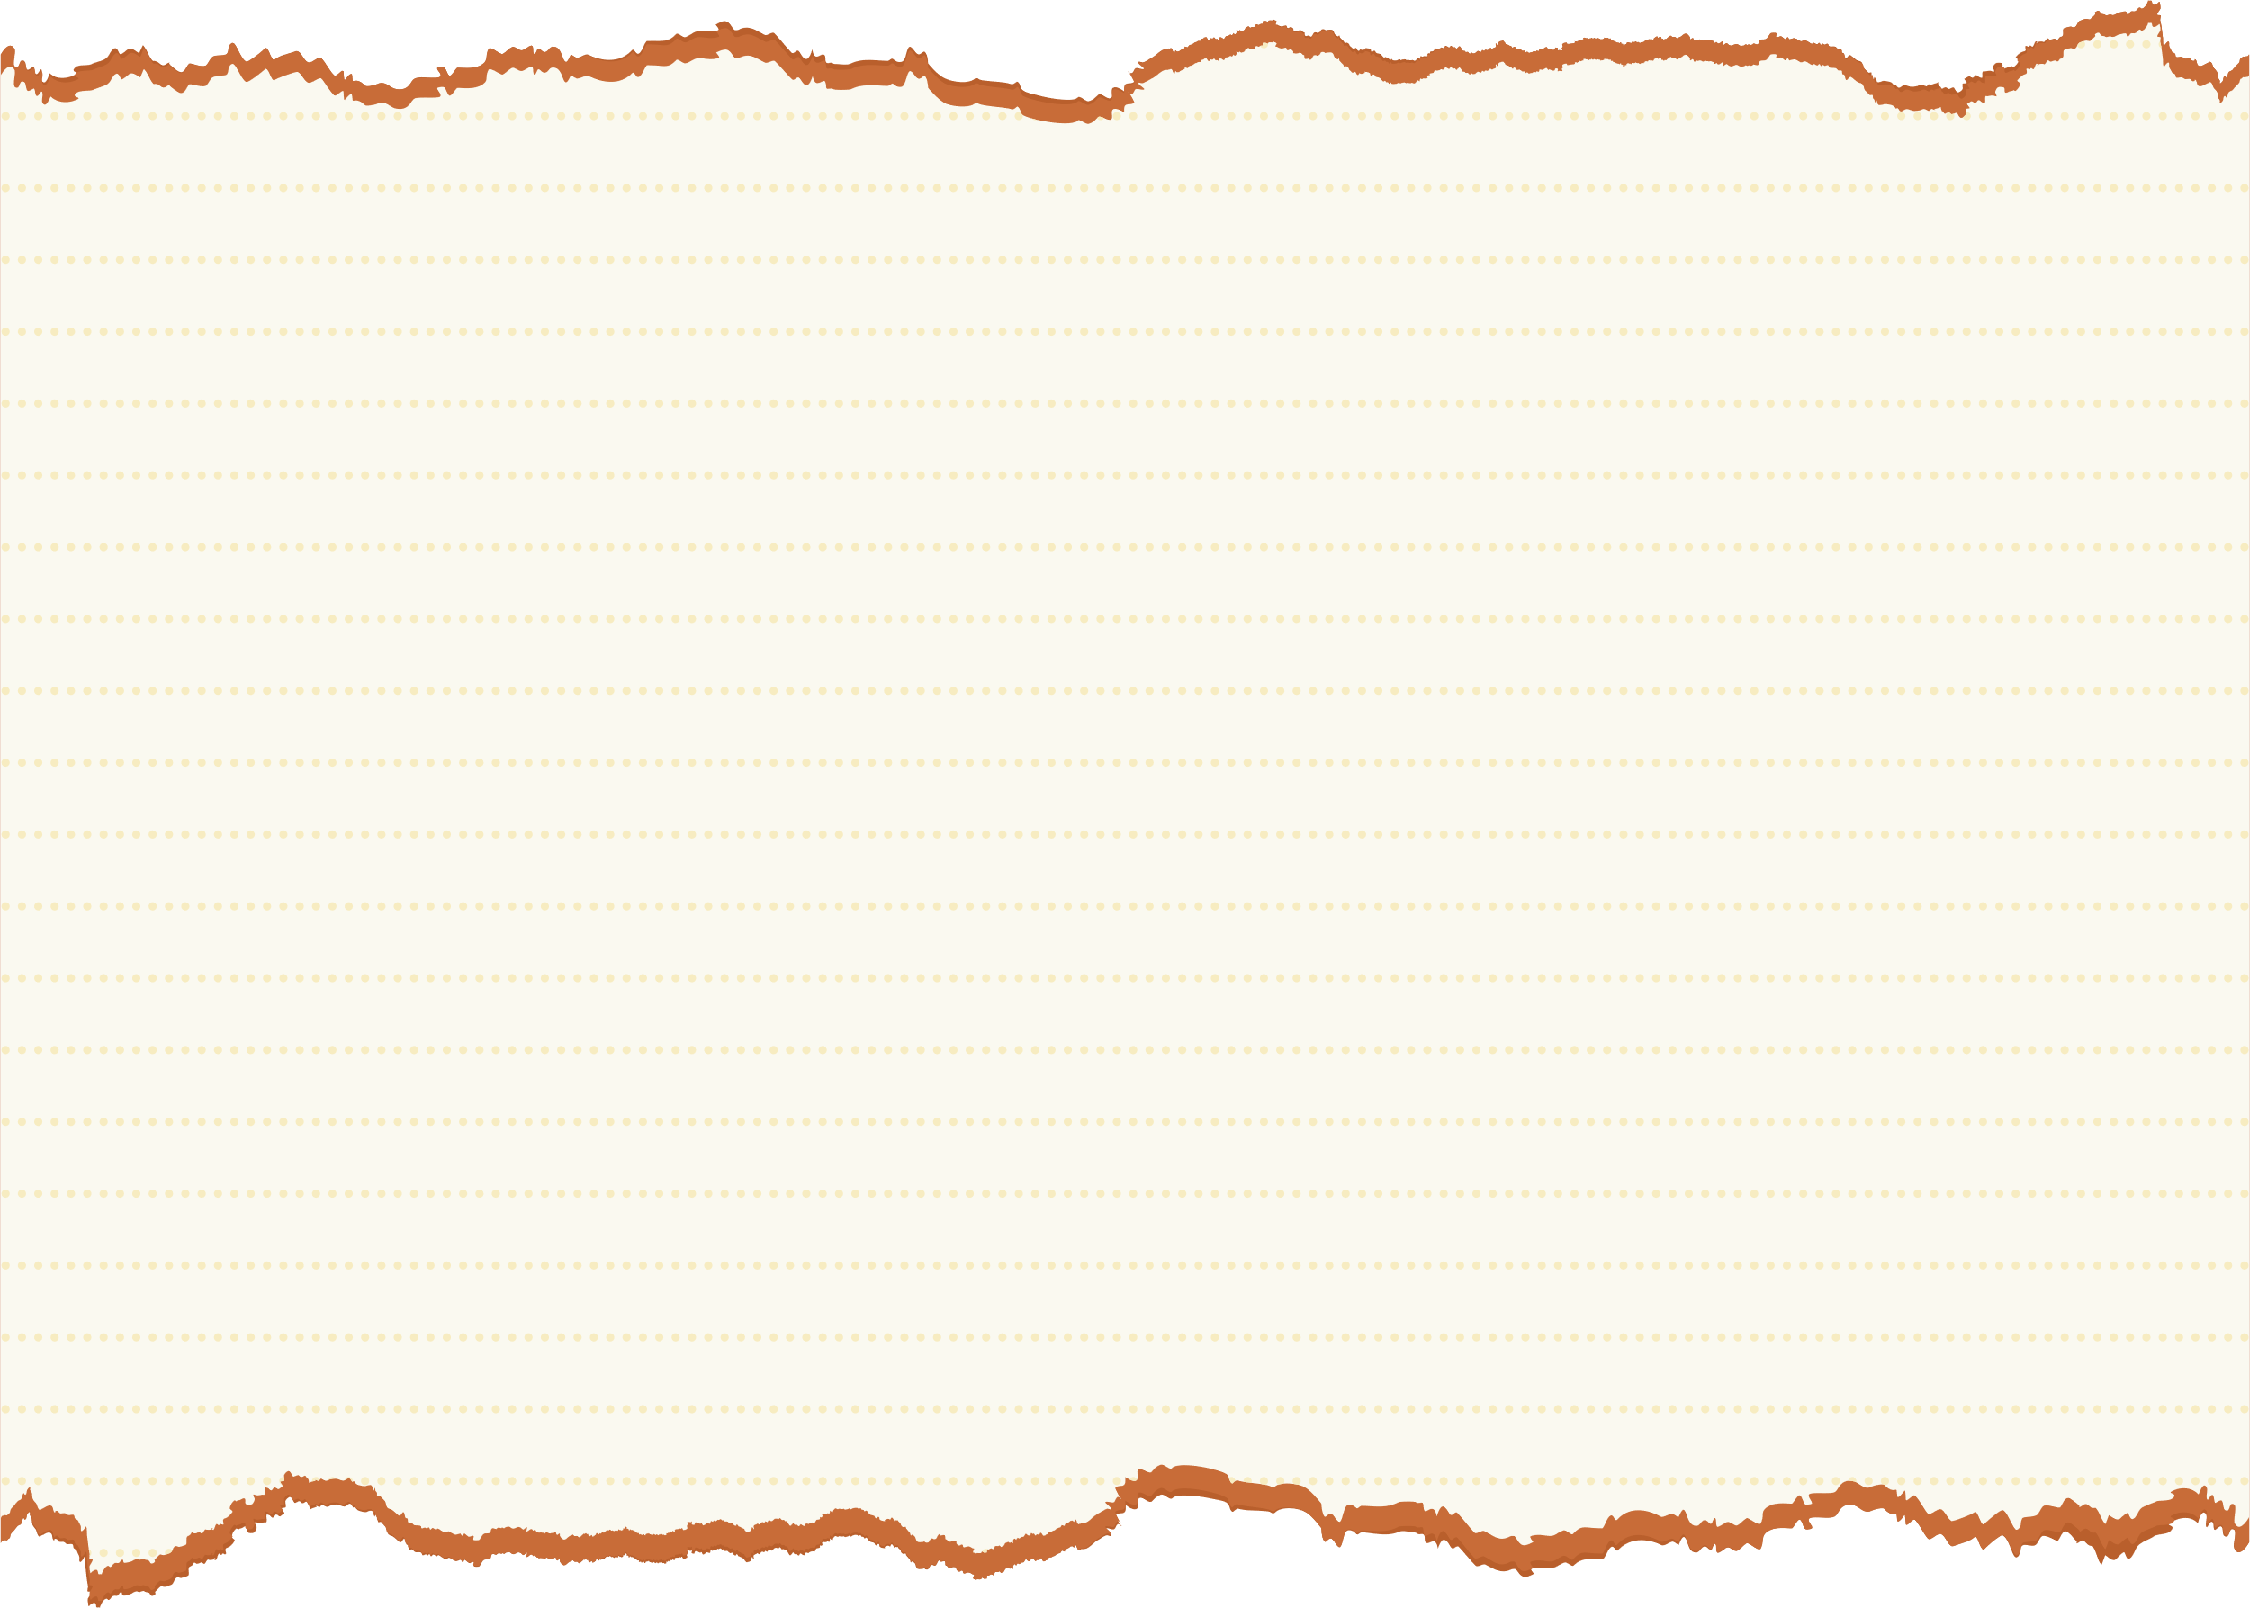
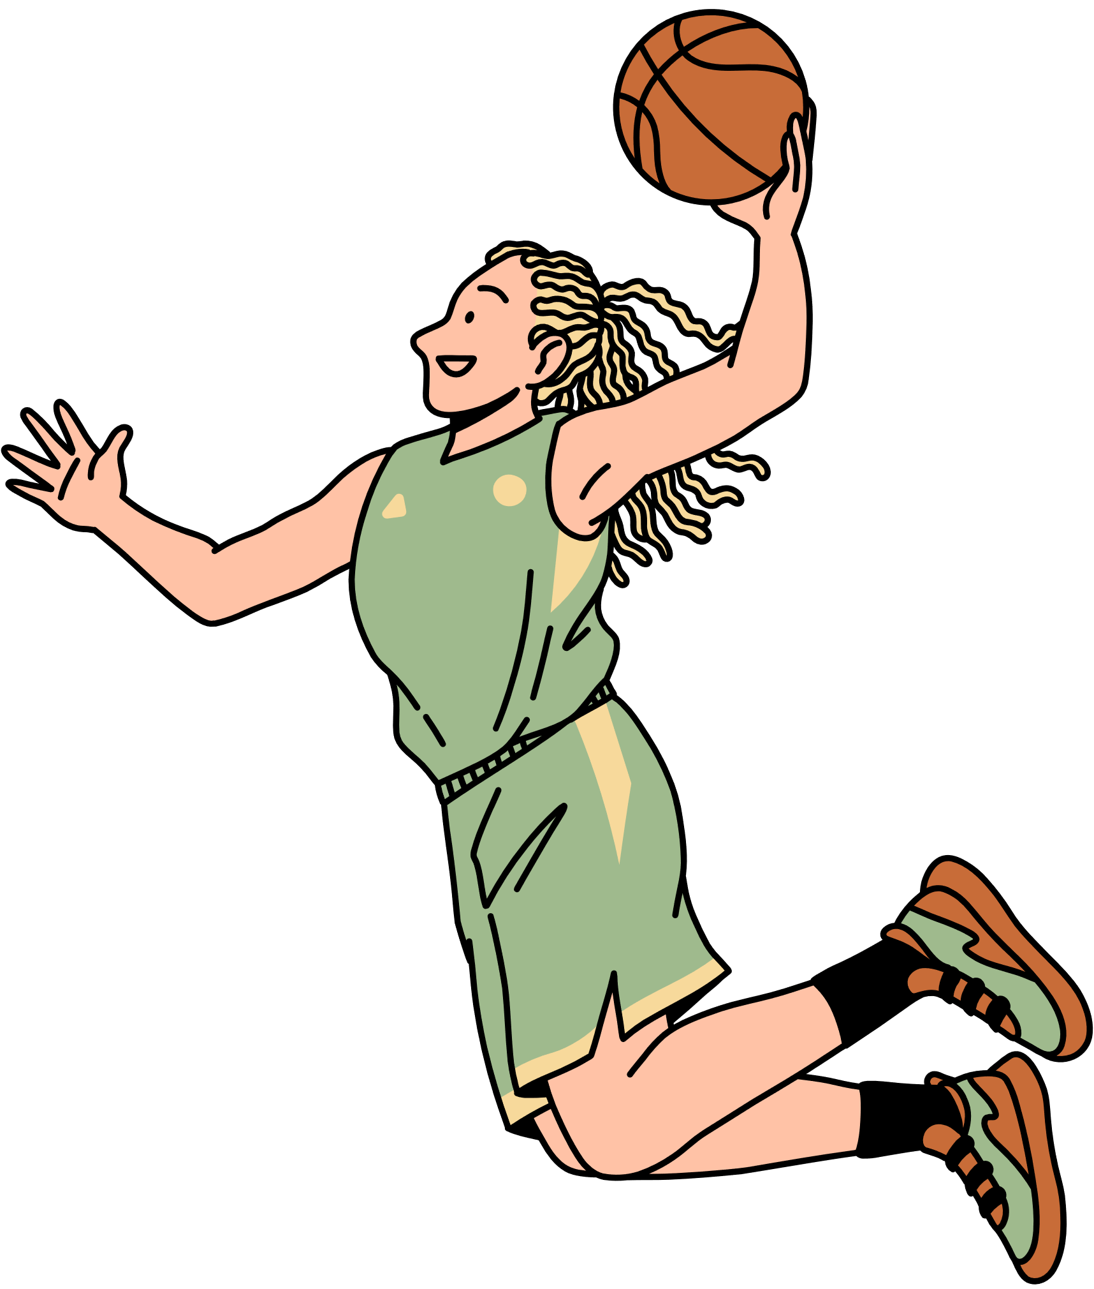
What biomechanical features make a good shot and How do you identify them?
Hard to identify key features of a "good" vs. "bad" shot
Statistical models are too complex and involve numerous variables.
Deep learning models are powerful but act as "black boxes"— hard to interpret or trust.
Our solution: Sportlets identify the most informative local movement patterns given an outcome and visualise them!
The extracted shapelets can also be used to perform downstream analysis. eg Kinematic Chains

Slide 3
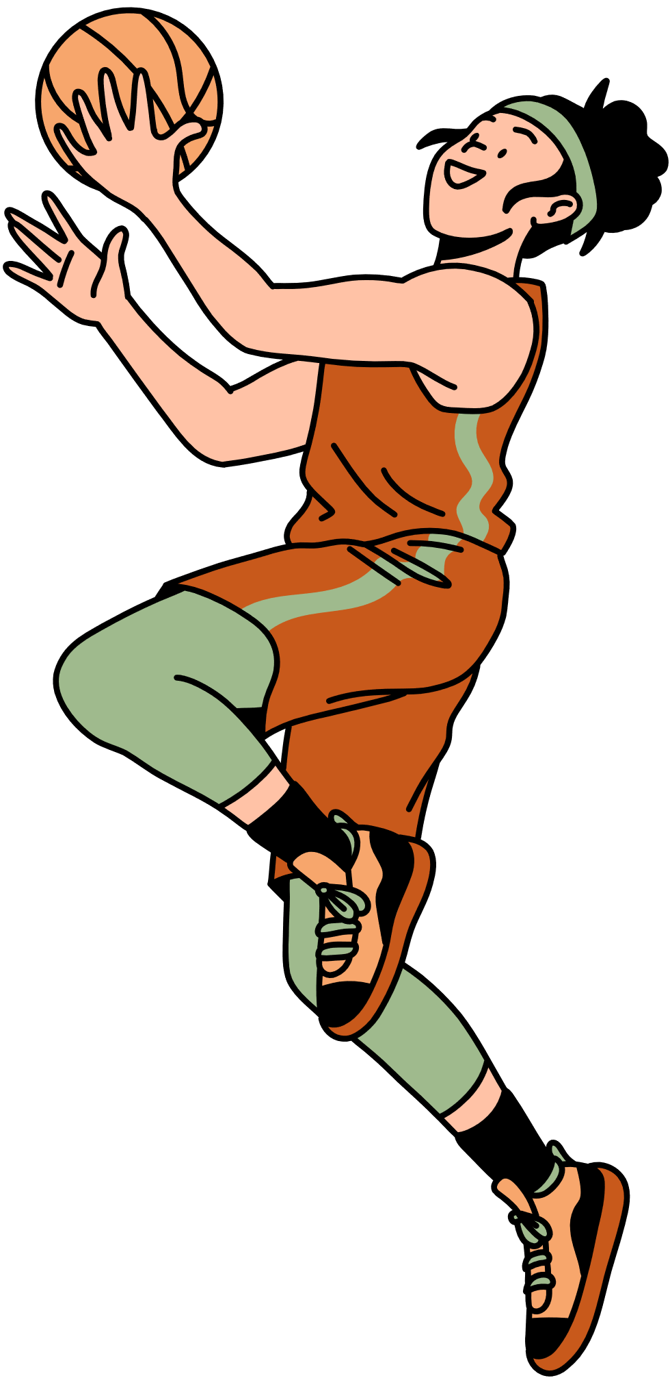
Sportlets: The Proposed Solution
What are Sportlets?
Multivariate shapelets: Small, meaningful submovement patterns extracted from time-series data.
Designed to be interpretable and focused on specific, local movements
Advantages:
Interpretable: Coaches and analysts can understand what specific movements drive performance.
Additional Features: Extremely easy to include additional features
Adaptable: Biomechanical restraints of particular sports can easily be added for more accurate sport-wise analysis

Slide 4
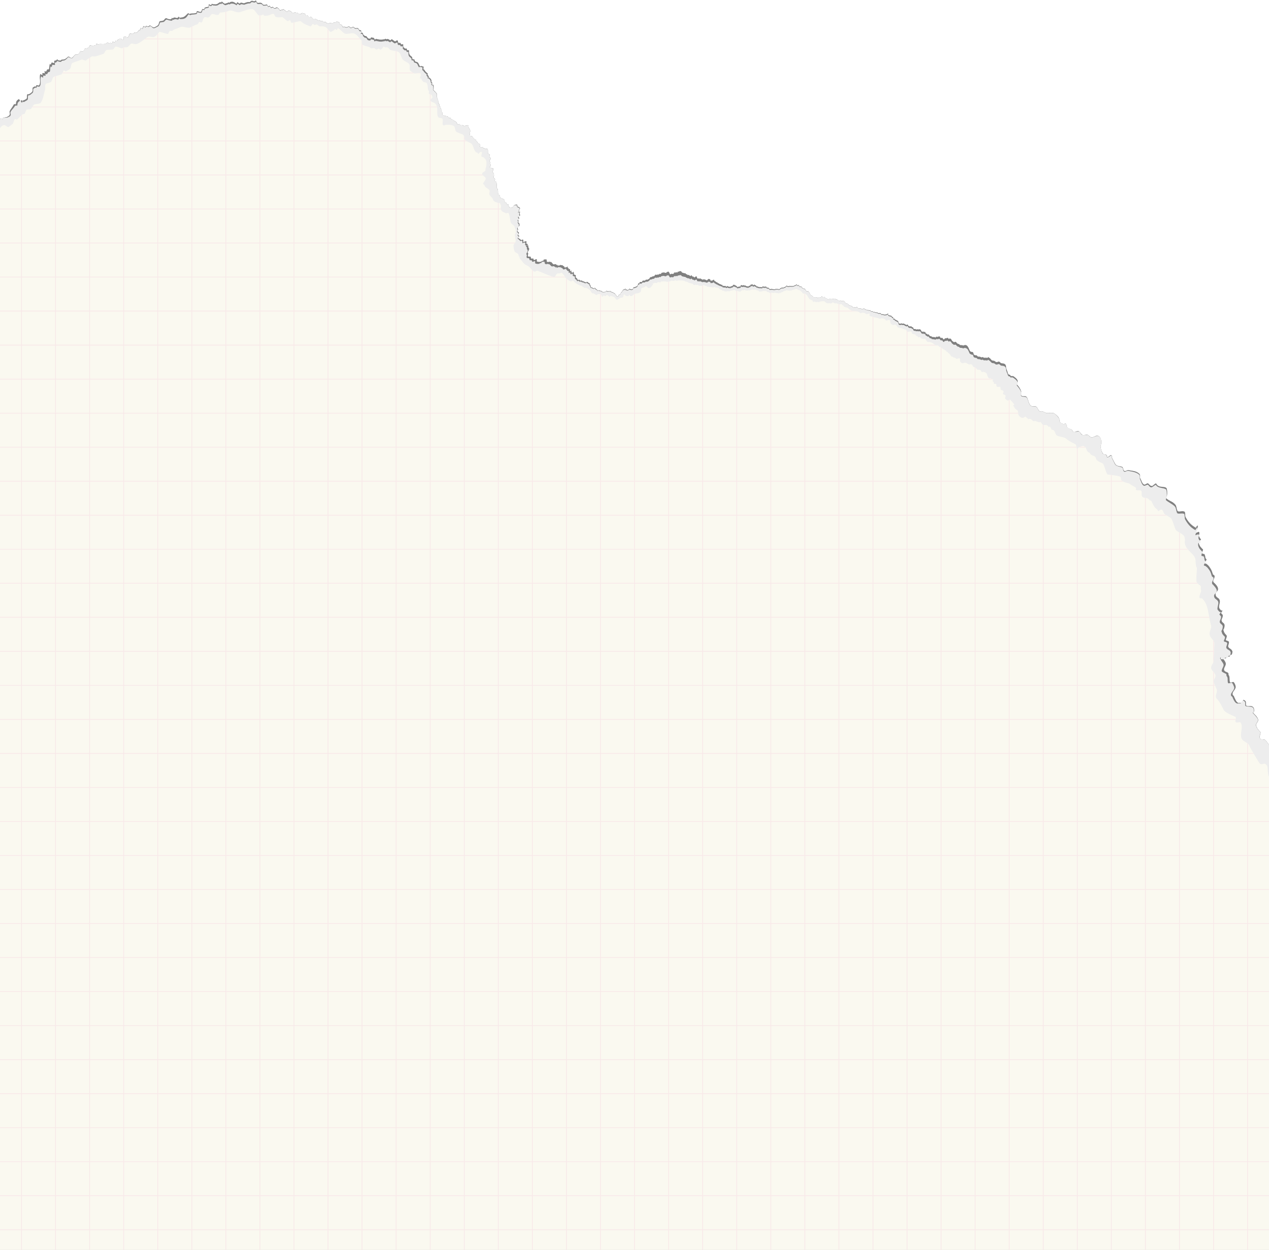
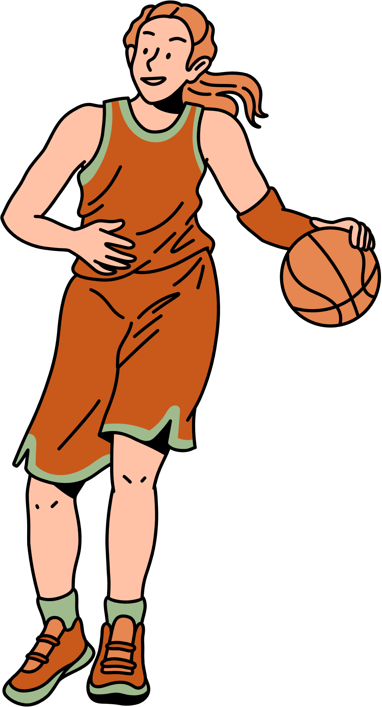
Our Method - Data Preprocessing
Segmentation
Using LOWESS we divide freethrows into the following segments: pre-preparation phase, preparation phase, shot phase, post-shot phase
We mainly consider the preparation and shot phase
Quaternions
To represent the upper kinematic chain we derived vectors from the shoulder to the elbow, elbow to the wrist and used quaternions to represent their joint and individual rotations through time.

Slide 5
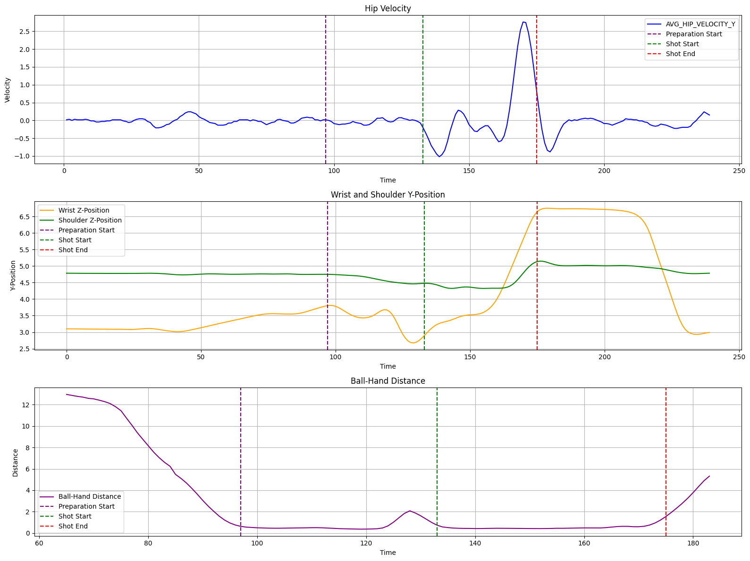
Data Preprocessing - SegmentatIon

Slide 6
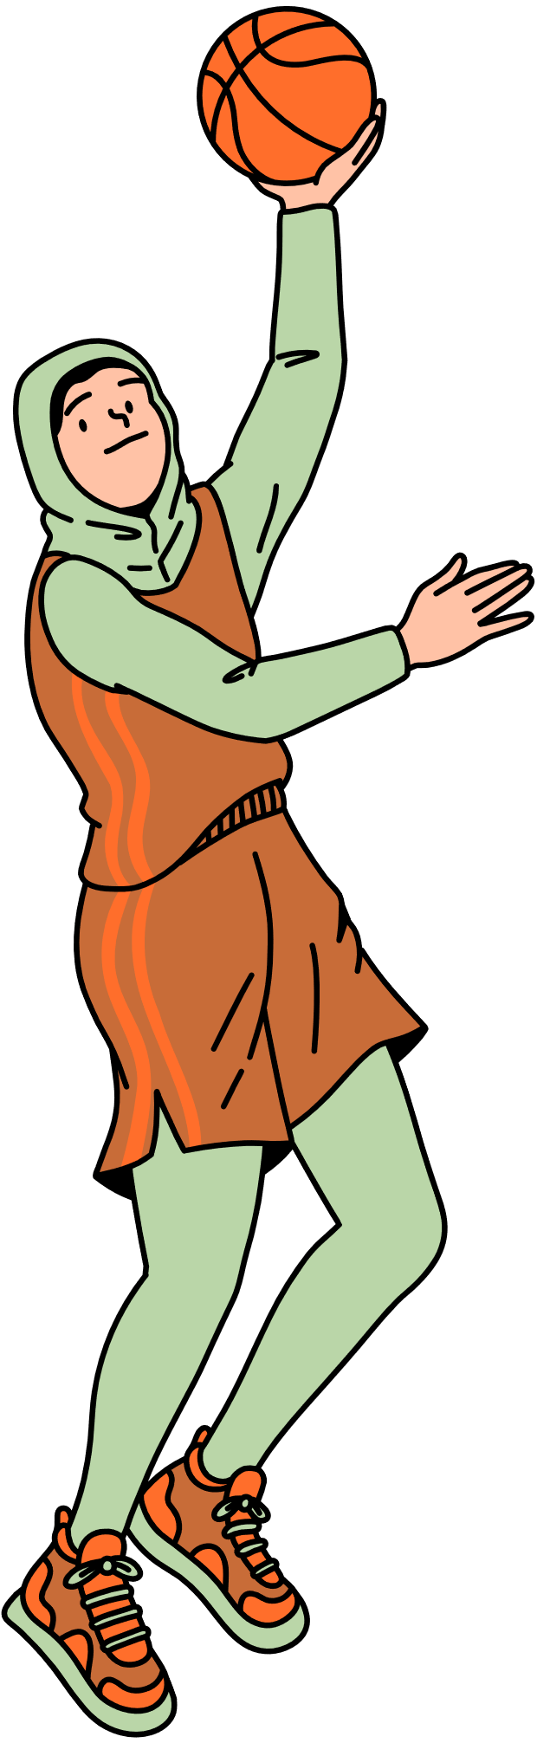
Our method - Analysis
Sportlets
Identification: Novel Gradient-based using biomechanical restraints to ensure realistic and accurate shapelets.
Distance-Metric: We use Dynamic Time Warping to ensure sportlets are robust to subtle variations in shooting performance
Experiments: We investigated a variety of sportlets durations and numbers to pick the best subsets of shapelets.
Reconstruction
To enable a visual analysis of the shapelets. We create gifs and compare them with actual trials.
Shapelets are defined using a position vector and a subsequence of the initial quaternion sequence.
Statistical Analysis
Chi-Square Test: Testing the presence of the sportlet with shot performance

Slide 7
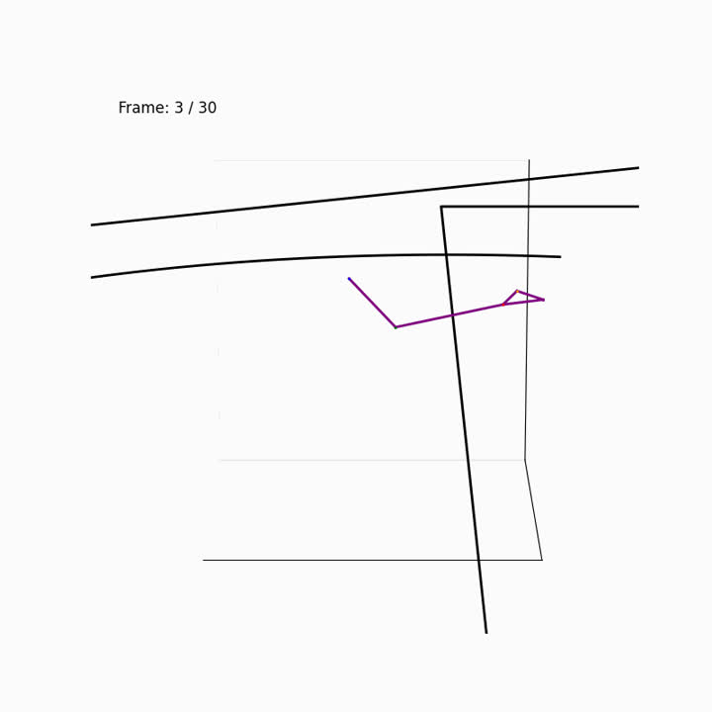
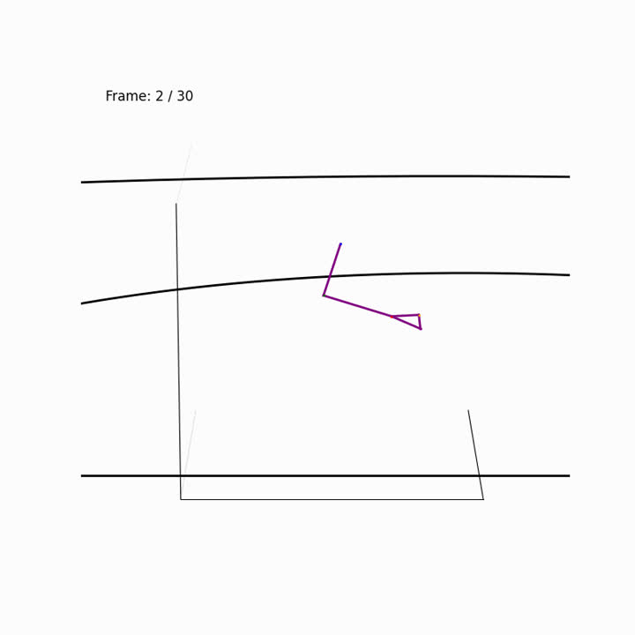
Our method- Best Shapelet
Sideway View azim 270
Sideway View azim 0
Corresponds to the shooting posture. Especially the final shooting motion.

Slide 8
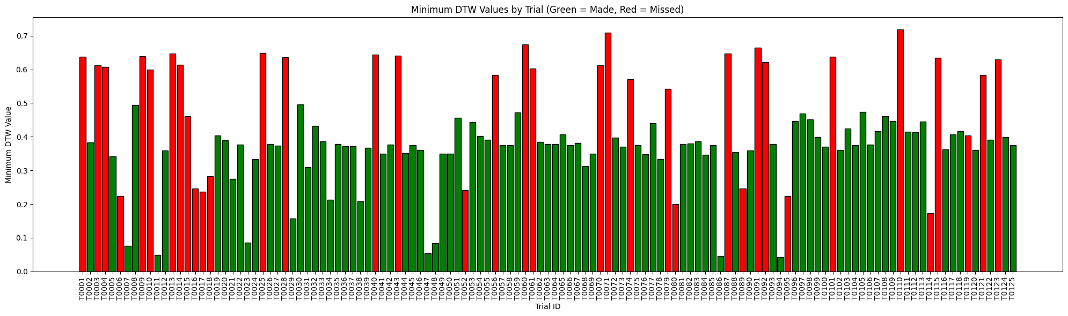
Our method- Closeness
Min DTW measures the minimum distance between the shot and the shapelet. Still some room for improvement

Slide 9
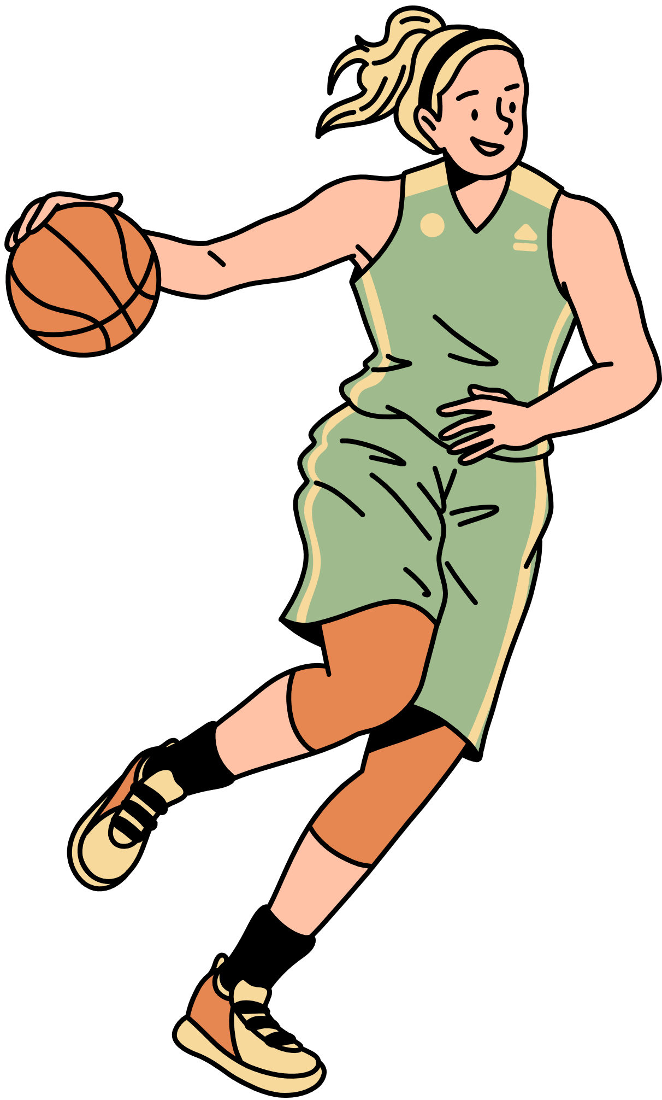
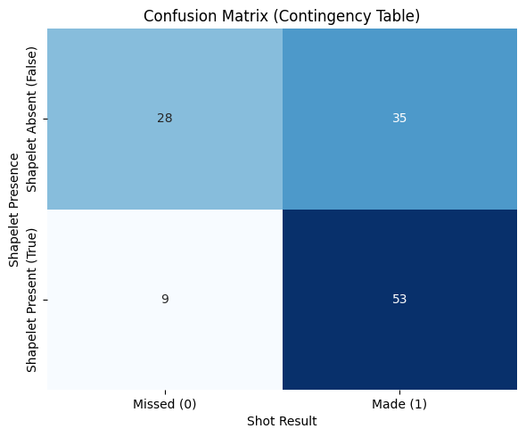
Results - Statistical Analysis
Chi-Square Test: Presence of the shapelet vs Shot made or not
DTW threshold: 0.3804 (Median DTW score)
Results: Significant with a p-value < 0.05 (0.000574)

Slide 10
Discussion
The loss-minimising submovement duration was 30 frames (1 second) with just 1 sportlet
Best sportlet were found with constraints for smoothness, body dimension consistency, jerk, angle restraints for elbow and with DTW as distance measure
Most stable with cosine annealing LR scheduler and with a sinusoidal exploration/compactness tradeoff values

Slide 11


Challenges
Dataset Size: Analyzed Sportlets still have some jitters and unrealistic movements due to the size of the dataset
Dimensionality: The sportlets are unable to capture longer kinematic chains as the fit gets poorer with additional joint
Lots of Hyperparam Tuning: Accurate and reliable shapelets need a lot of tuning on both the number, length and loss function.

Slide 12
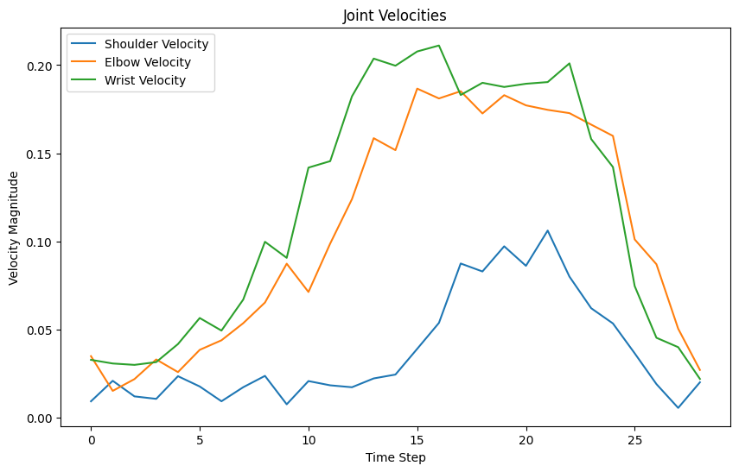
Sportlet Insights - Kinematic Chains
Method?
We extract the velocity magnitude of the various joints to give some representation of the energy transfers
Shoulder lowest velocity indicating that it mainly is for stability
The velocity graphs of the elbow and wrists are similar, although lower on Average for the elbow
The wrist has the highest energy and consistently, indicating energy generation

Slide 13
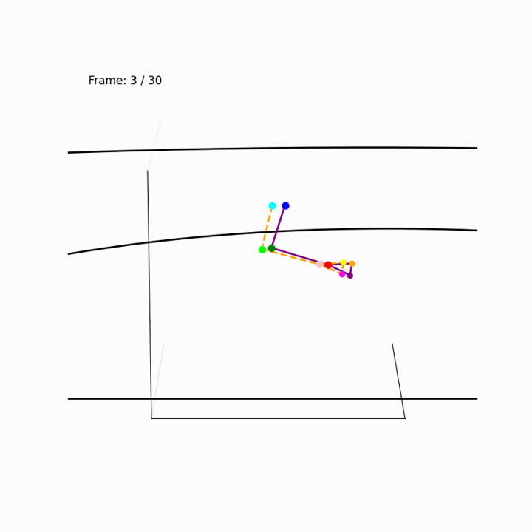
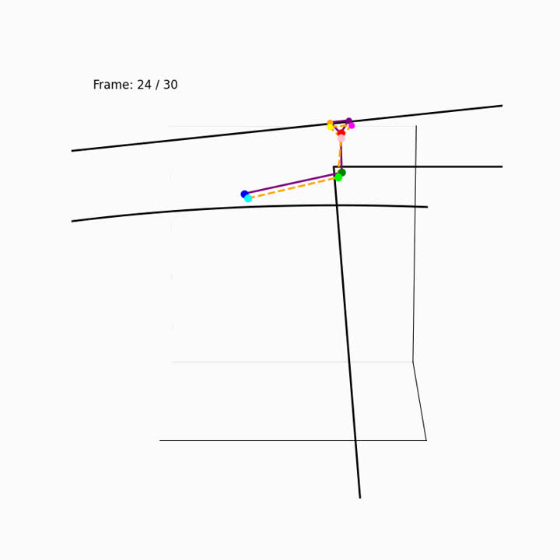
Sportlet Insights - Comparisons
Sideway View azim 0
Sideway View azim 270

Slide 14
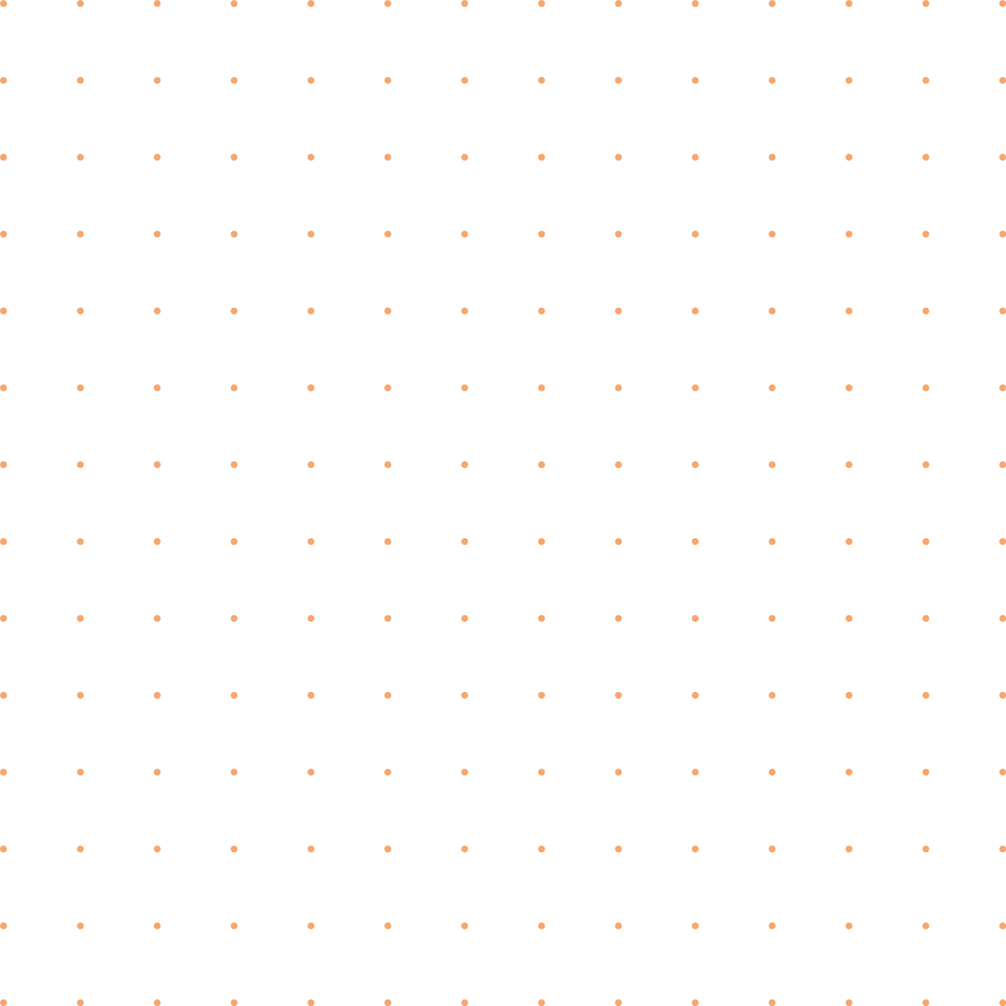

Future Improvements
Experiment with larger kinematic chains to further capture movements
Train model with respect to distance from the center of net to extract insight into movements that influence distance from the center
Experiment with different sports to understand the effectiveness of sportlets further

Slide 15
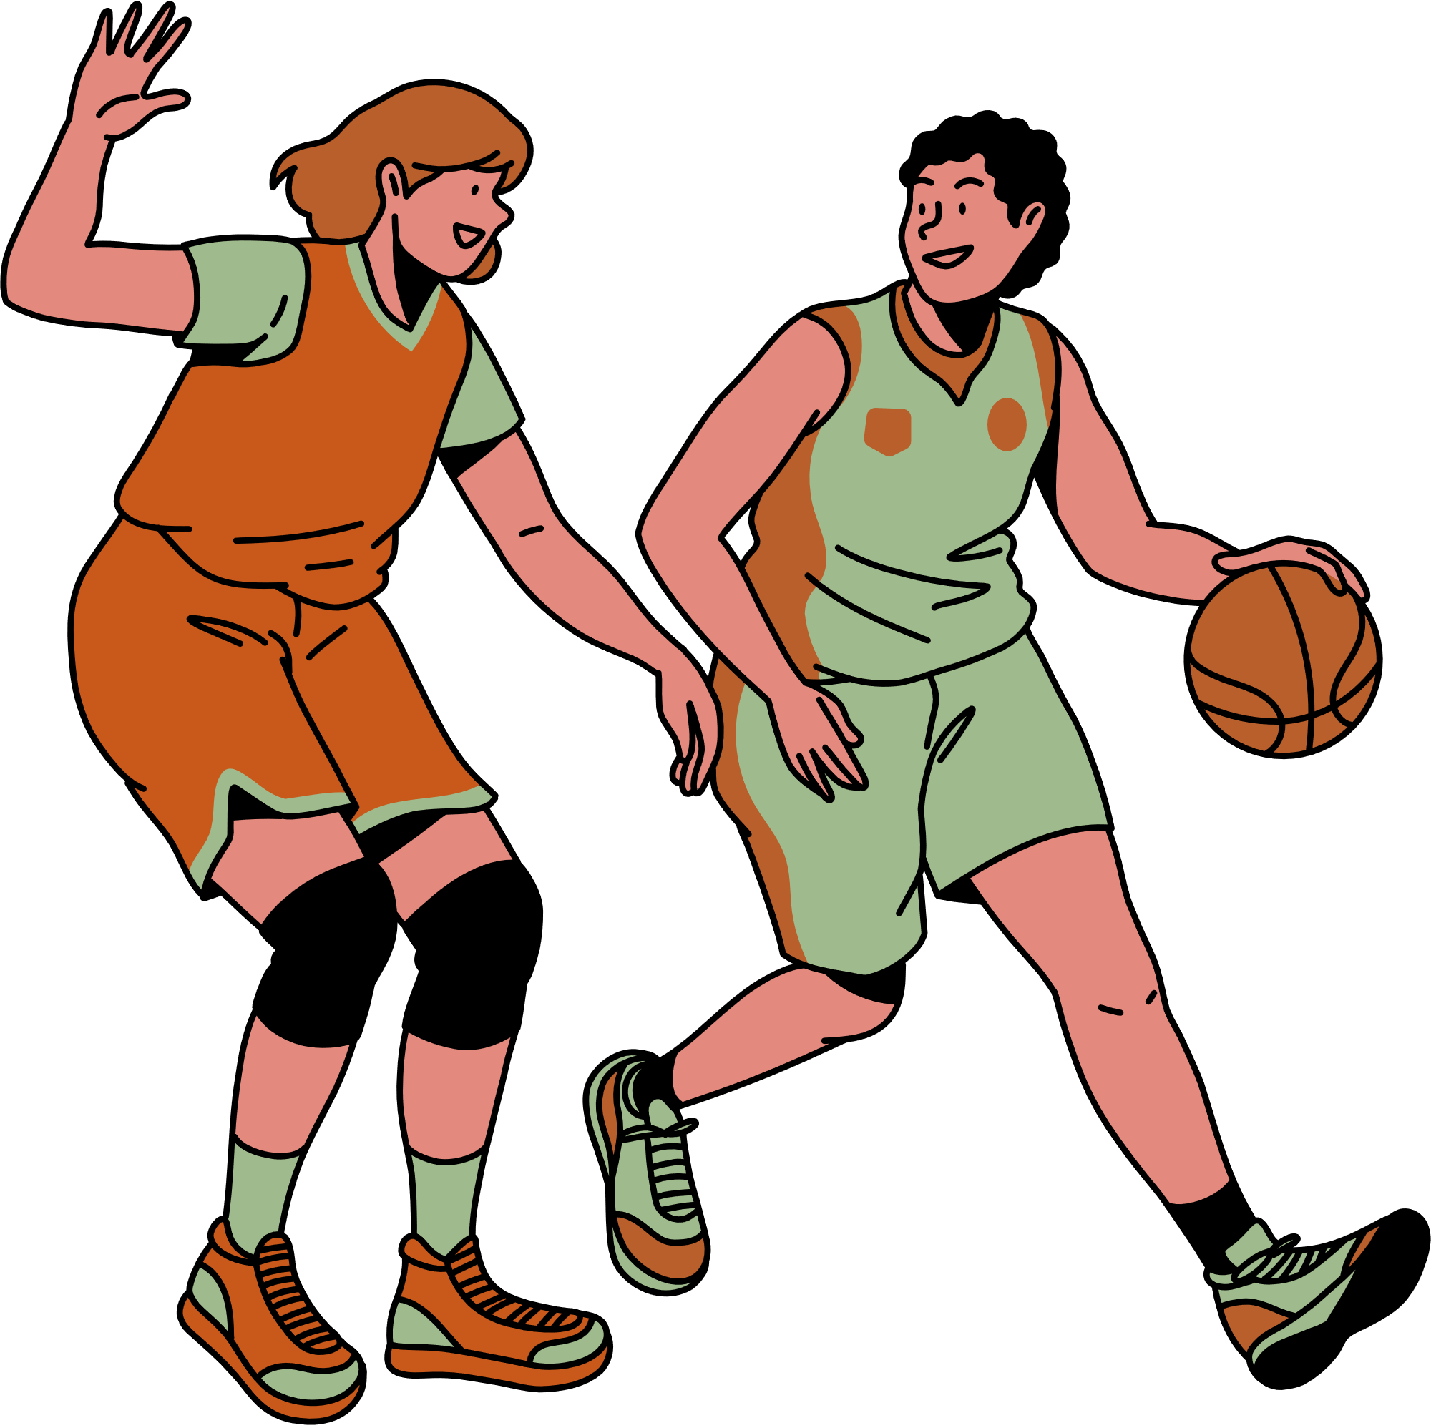
Thank you

